Slide 1
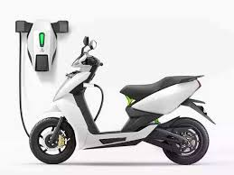
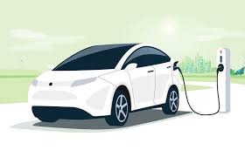
Market Analysis for AtliQ Motors' EV Expansion in India
Detailed Study of Electric Vehicle Sales and Trends in India (2022-2024)
Presented by: Surendra Bokka

Slide 2
Problem Statement & Objectives
Problem Statement: AtliQ Motors, a leading automotive giant from the USA with a 25% market share in North America, aims to expand in India where their share is below 2%. A detailed market study is required to guide this expansion.
Objectives:
Identify key trends in EV sales.
Analyze penetration rates across states.
Provide actionable recommendations for market entry.

Slide 3

Data, Metrics & DAX
Datasets:
electric_vehicle_sales_by_state.csv
electric_vehicle_sales_by_makers.csv
dim_date.csv
Key Metrics:
Penetration Rate: (ElectricVehiclesSold/TotalVehiclesSold)∗100(Electric Vehicles Sold / Total Vehicles Sold) * 100(ElectricVehiclesSold/TotalVehiclesSold)∗100
CAGR: (EndingValue/BeginningValue)∗∗(1/n)−1(Ending Value / Beginning Value) ** (1 / n) - 1(EndingValue/BeginningValue)∗∗(1/n)−1
DAX Measures:
Penetration Rate
CAGR EV Sales
CAGR Total Sales
Revenue Growth Rate

Slide 4
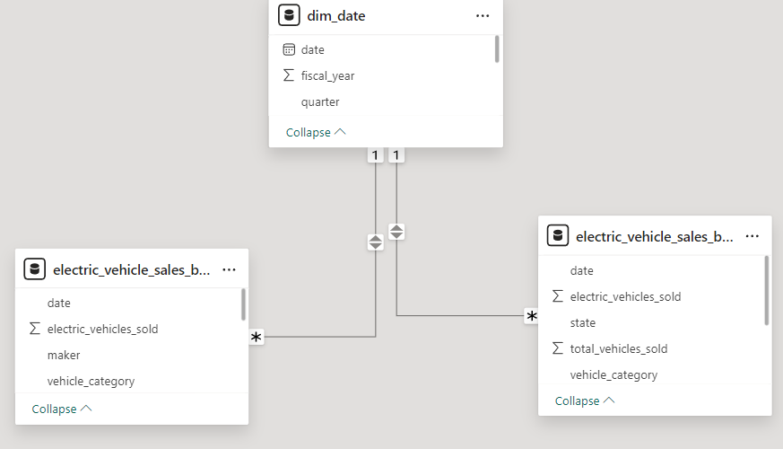
Data Relationships

Slide 5
Primary Analysis
Top & Bottom 3 Makers (2023-2024):
Top 3 (2-Wheelers): Ola Electric, TVS, Ather
Bottom 3 (2-Wheelers): Battre Electric, Jitendra, Kinetic Green
Top 5 States by Penetration Rate (2024):
2-Wheelers: Goa, Kerala, Karnataka, Maharashtra, Delhi
4-Wheelers: Kerala, Chandigarh, Delhi, Karnataka, Goa
States with Negative Penetration (Decline 2022-2024): Sikkim (0)
Quarterly Trends (4-Wheelers):
Top Makers: Ampere, Ather, Hero Electric, Ola Electric, TVS
EV Sales & Penetration Rates Comparison (2024):
Delhi: Sales: 47K, Penetration Rate: 7.7%
Karnataka: Sales: 161K, Penetration Rate: 10.2%

Slide 6
Top 10 CAGR (4-Wheelers 2022-2024): BMW India, BYD India, OLA Electric, TVS, Volvo Auto India
Top 10 States by CAGR (2022-2024): Meghalaya, Goa, Karnataka, Delhi, Rajasthan, Gujarat, Assam, Mizoram, Arunachal Pradesh, Haryana
Peak & Low Season Months:
Peak: March, April, October, November => 2022 March, May, November => 2023 March => 2024
Low: January => 2022 April, June => 2023
Projected EV Sales (2030):
Revenue Growth Rate Estimates:
2-Wheelers (2022 vs 2024): 269%
2-Wheelers (2023 vs 2024): 28%
4-Wheelers (2022 vs 2024): 368%
4-Wheelers (2023 vs 2024): 83%

Slide 7
Insights
Key Observations:
High Growth States: States like Karnataka and Kerala show robust growth in EV adoption, suggesting a strong market potential.
Sales Trends: Consistent growth in both 2-wheeler and 4-wheeler segments, with significant growth in the 4-wheeler category.
Seasonality: Sales peak during specific months, indicating favorable periods for marketing and promotions.
Revenue Impact: Substantial revenue growth for 4-wheelers highlights strong market interest and potential profitability.

Slide 8
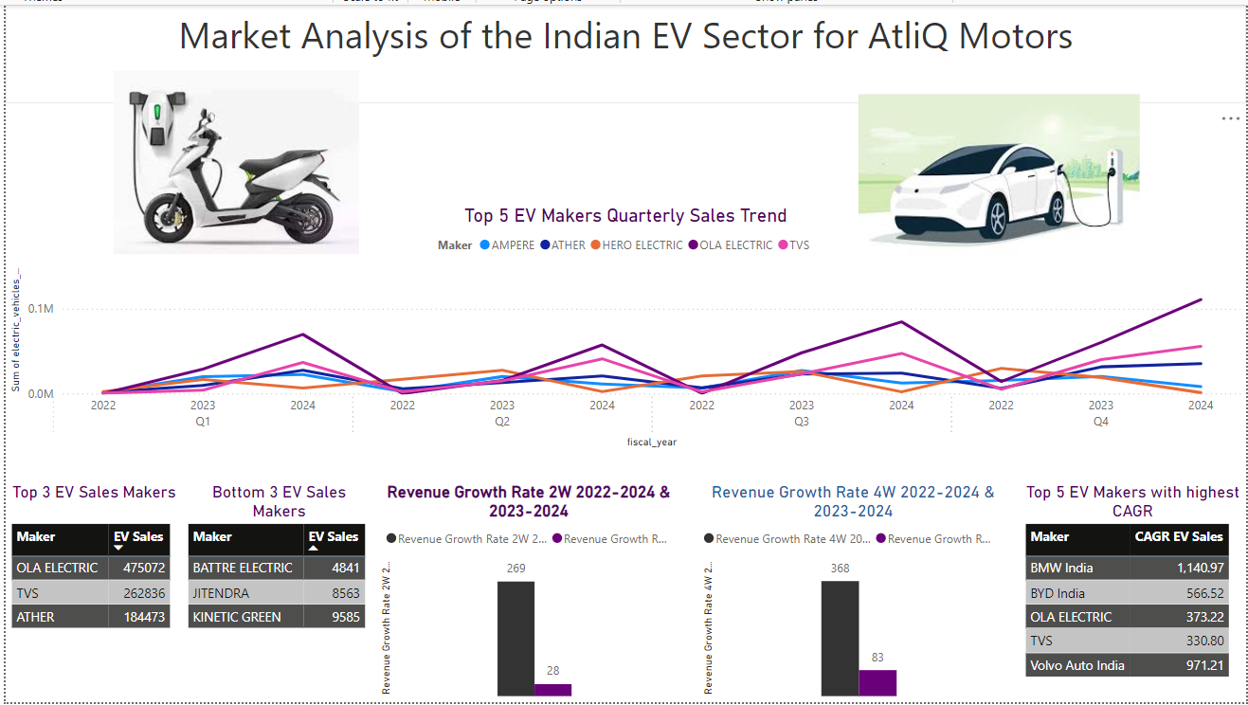
Visualizations & Dashboard

Slide 9
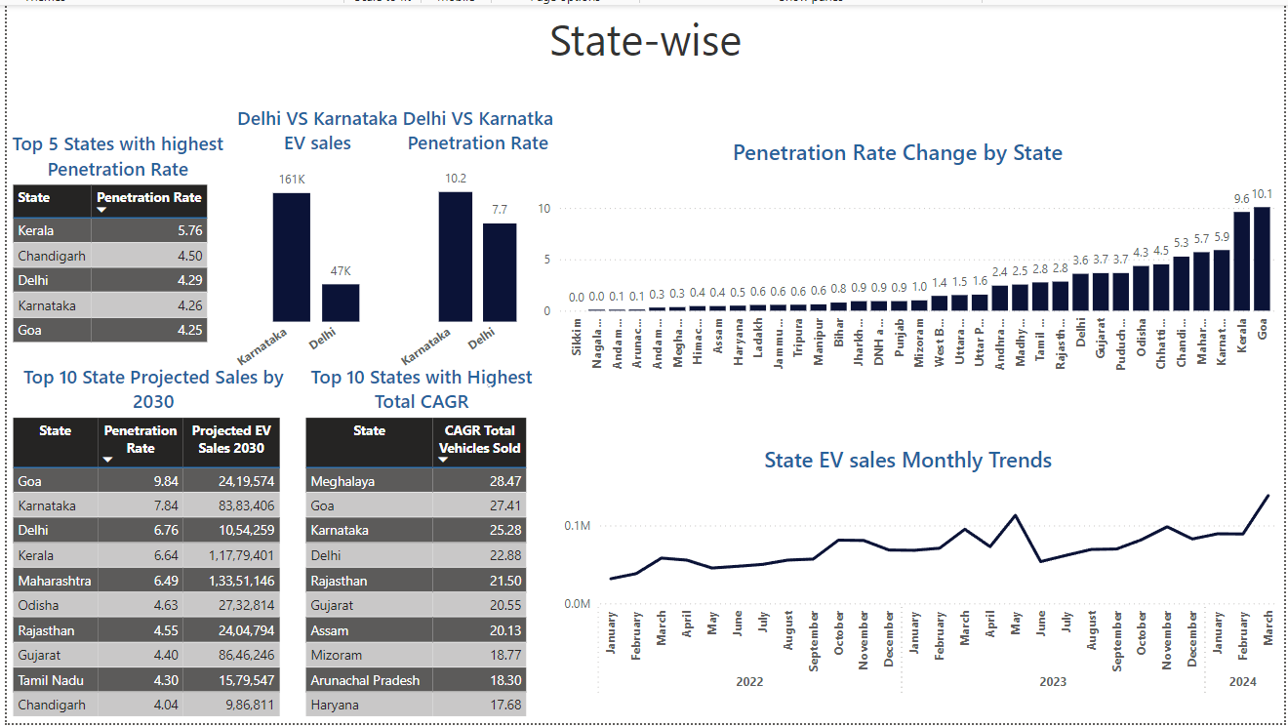

Slide 10
Recommendations
Market Penetration:
Focus on Karnataka and Kerala, where EV adoption rates are highest.
Leverage the strong presence of 4-wheelers in Kerala and Chandigarh.
Partnerships:
Collaborate with local charging infrastructure providers to enhance accessibility.
Explore and utilize government incentives in high-growth states.
Product Strategy:
Emphasize cost savings and environmental benefits in marketing strategies.
Consider launching region-specific models or variants.
Brand Ambassador: Choose a well-known and environmentally conscious celebrity to enhance brand appeal.
Manufacturing Base: Evaluate Karnataka or Maharashtra for manufacturing units due to favorable policies.

Slide 11
Next Steps:
Conduct a detailed pilot launch in top-performing states.
Continuously monitor market trends and adapt strategies.
THANK YOU

